Slide 1

24BITS EVENTS TICKET
ONLINE EVENT RESERVATION PLATFORM
Developed by the TRIPLE LOGIC MOBILE
Lucky Asenoguan
Alekwe Theresa
Dylan Nchungong

Slide 2
Introduction
24Bits is an online mobile application designed to make event ticket booking seamless and secure. The app allows users to browse upcoming events, view detailed information, and book tickets directly from their smartphones. Each ticket is generated with a unique QR code for easy entry and verification at venues

Slide 3
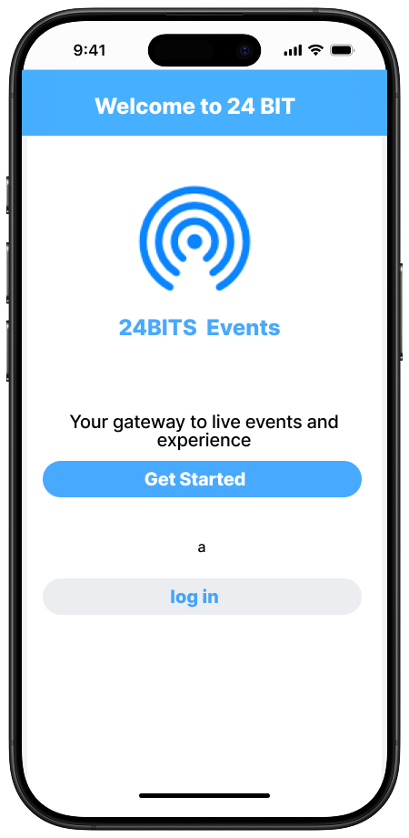
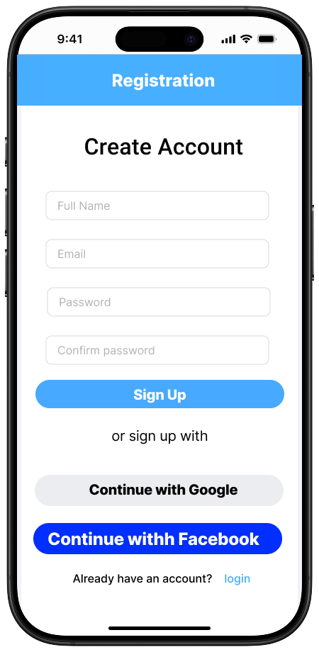
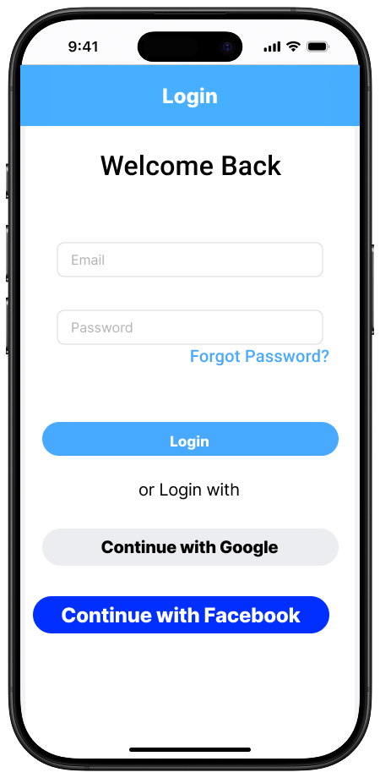
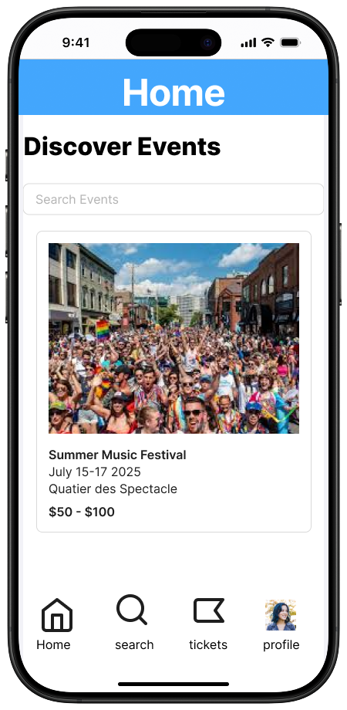
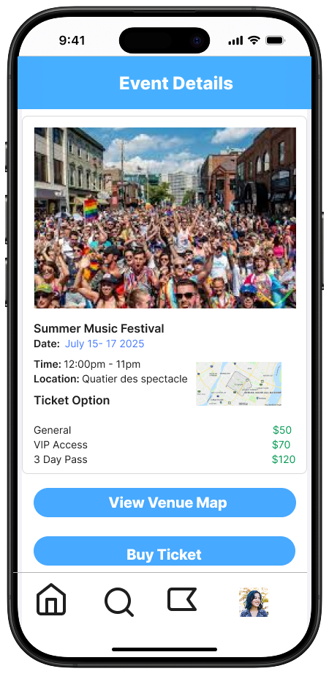
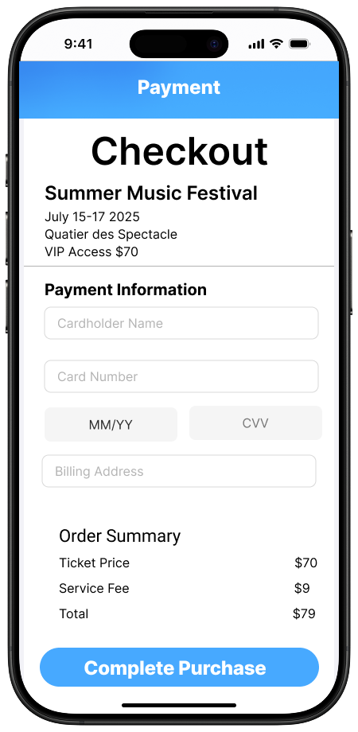
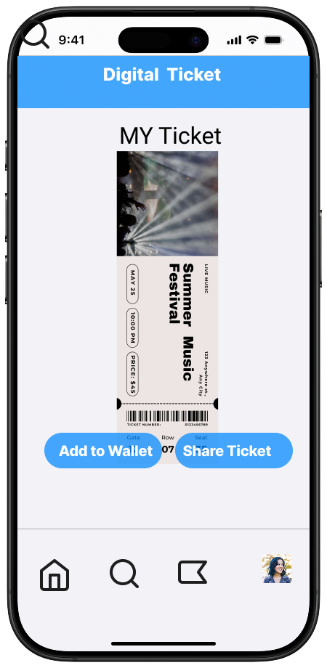
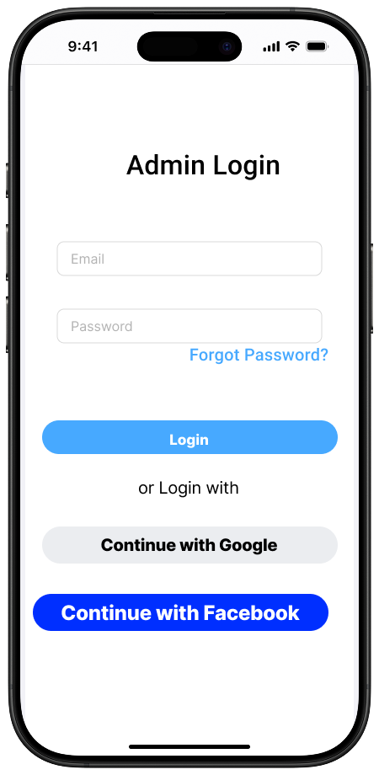
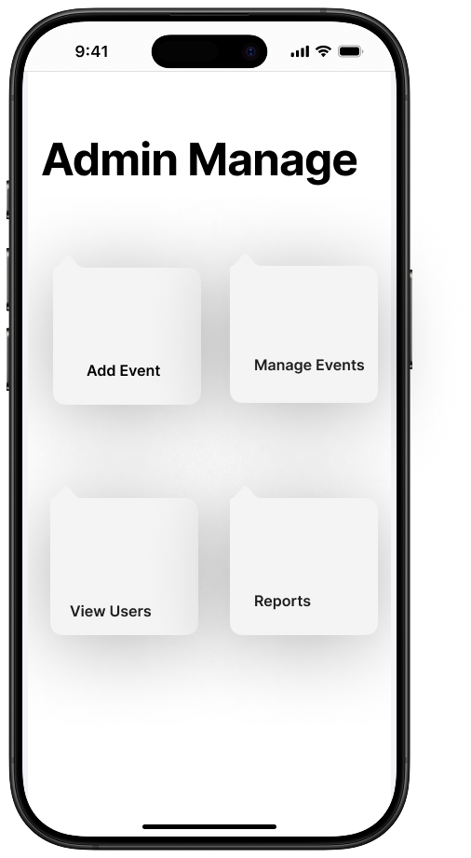
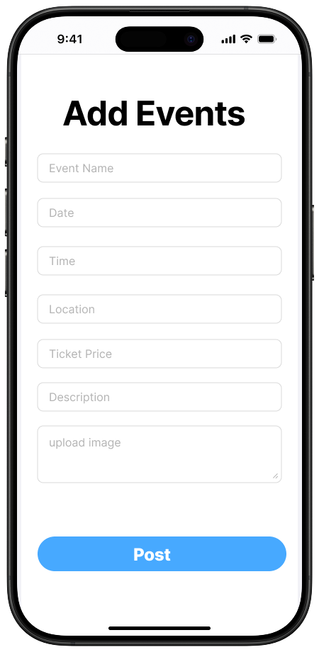

Slide 4
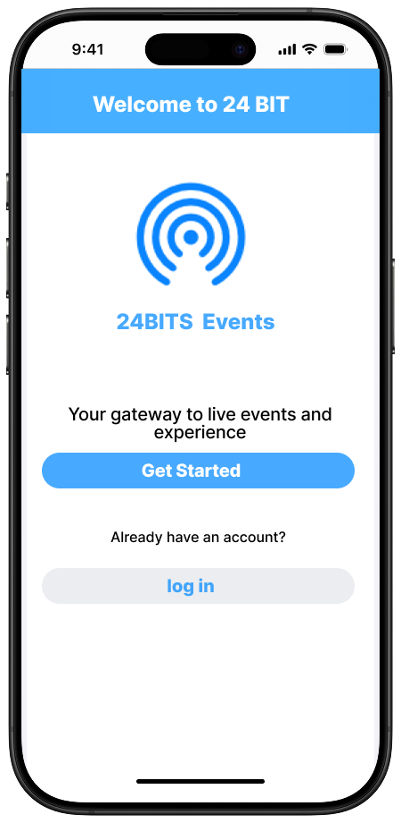
Welcome Screen
The Welcome Page is the first screen users will see when launching the 24Bits Event Ticket App. This page serves as a warm introduction to the app, setting the tone for the user experience. It aims to provide a seamless entry point into the app's core features, like browsing events and logging in

Slide 5
Registration Screen
The Registration Page allows new users to create an account on the 24Bits Event Ticket App. This page is designed to be simple, intuitive, and secure. It collects necessary information from users while ensuring that the process is quick and easy to navigate

Slide 6
Login Screen
The Login Page is designed to allow existing users to sign in to their 24Bits Event Ticket App account. It’s streamlined for quick access, ensuring users can enter their credentials efficiently to start browsing or booking event tickets. This page emphasizes security and ease of use

Slide 7
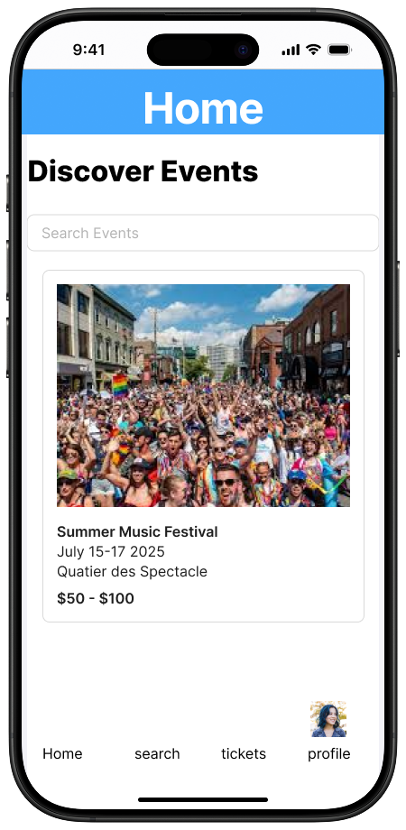
Home Feed Screen
The Home Feed Page is the core of the 24Bits Event Ticket App, where users can browse through a curated list of upcoming events, discover new activities, and explore options for ticket booking. This page is designed to be visually engaging, with an easy-to-navigate layout for a seamless user experience.

Slide 8
Event Details Screen
The Event Details Screen provides users with all the essential information about a specific event. This page is designed to give a comprehensive overview, including event descriptions, schedules, ticket options, and location map details, allowing users to make informed decisions before booking their tickets. It serves as the final decision-making point before purchasing tickets for the event.

Slide 9
Payment Screen
The Payment screen is a secure and streamlined interface that allows users to finalize their ticket purchase for an event. It clearly displays all necessary details to ensure trust and transparency.

Slide 10
Digital Ticket Screen
The Digital Ticket screen provides users with instant access to their event ticket after a successful purchase. Designed for ease of use and fast entry at event venues, this screen confirms ticket ownership and enhances the overall user experience

Slide 11
Admin Login screen
The Admin Login screen is a secure entry point designed exclusively for authorized administrators to access backend tools and event management features.

Slide 12
Admin Manage screen
The Admin Manage screen gives administrators full control over events, users, reports, and ticket activity in one convenient location. It is designed for clarity, speed, and simplicity, helping admins stay organized and efficient.

Slide 13
Add Events Screen
The Add Events screen allows administrators to easily create and publish new events directly from the app. It’s designed for speed, clarity, and full control over the event setup

Slide 14
Other information
Tech Stack Overview:
Frontend: Flutter (Dart)
Backend & Services: Firebase (Auth, Firestore, Cloud Functions, Storage)
Version Control: Git & GitHub
Deployment: Firebase Hosting (for admin dashboard, if web-based) or Play Store / App Store (for mobile)
Security & Data Handling:
All user and admin data is stored securely in Firebase.
Login and admin access are protected with Firebase Authentication.
Ticket data is linked to user accounts with real-time access via Firestore.
Development Notes:
Built with modular design for easy scalability and maintenance.
Clean UI/UX following Flutter best practices.
CI/CD pipeline connected to GitHub for streamlined testing and deployment

